Slide 1
Network Fundamentals – Lecture 2

Slide 2
Objectives
Describe the structure of a network, including the devices and media that are necessary for successful communications.
Explain the function of protocols in network communications.
Explain the advantages of using a layered model to describe network functionality.
Describe the role of each layer in two recognized network models: The TCP/IP model and the OSI model.
Describe the importance of addressing and naming schemes in network communications.

Slide 3
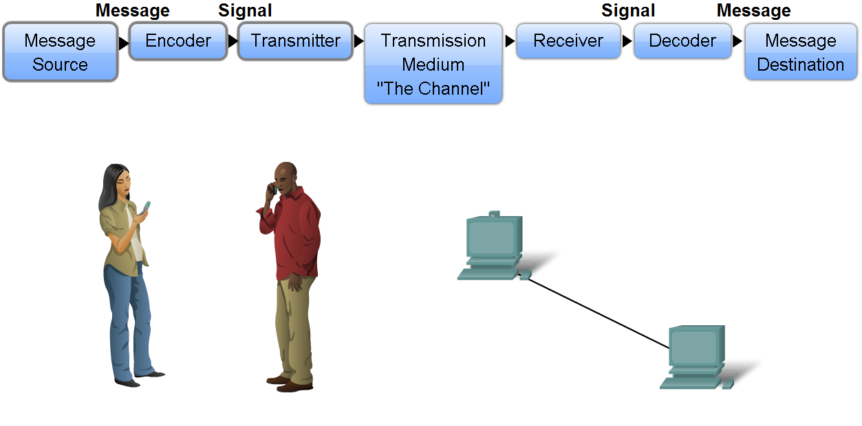
Network Structure
Define the elements of communication
3 common elements of communication
message source
the channel
message destination
Define a network
data or information networks capable of carrying many different types of communications

Slide 4
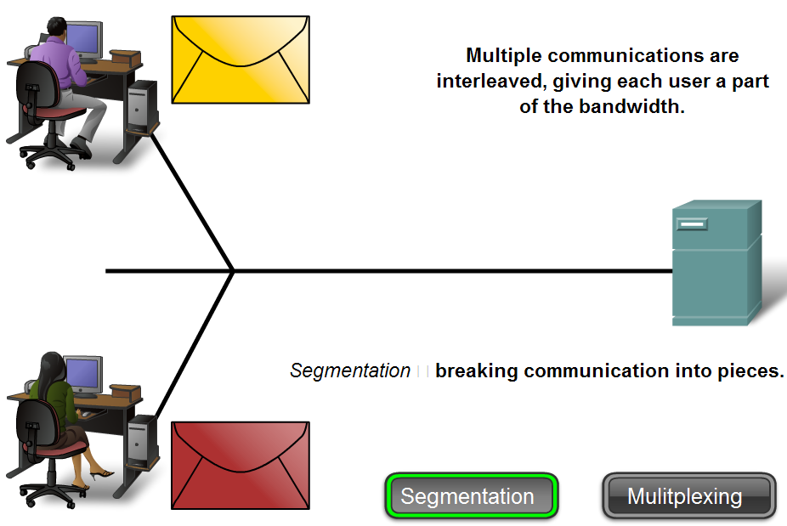
Network Structure
Data is sent across a network in small “chunks” called segments

Slide 5
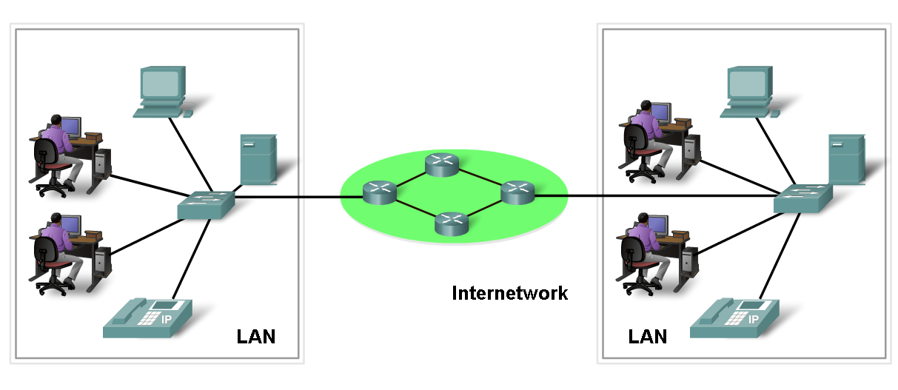
Network Structure
Network components
hardware
software

Slide 6
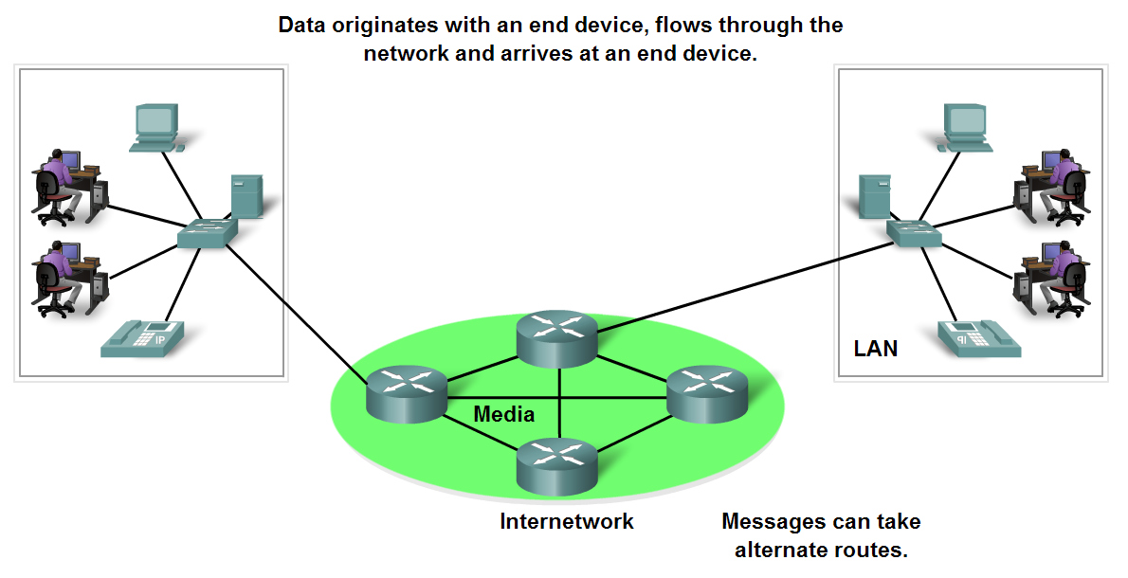
Network Structure
End devices form interface with human network & communications network
Role of end devices:
client
server
both client and server

Slide 7
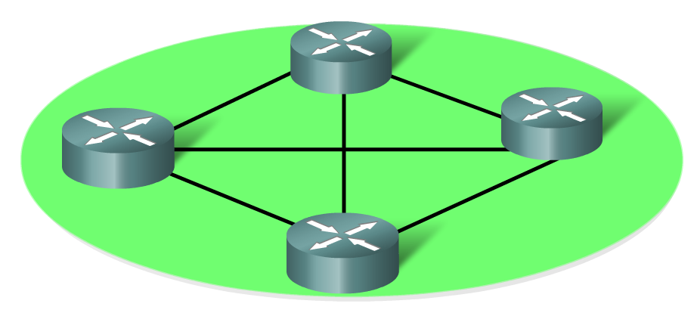
Network Structure
Role of an intermediary device
provides connectivity and ensures data flows across network

Slide 8
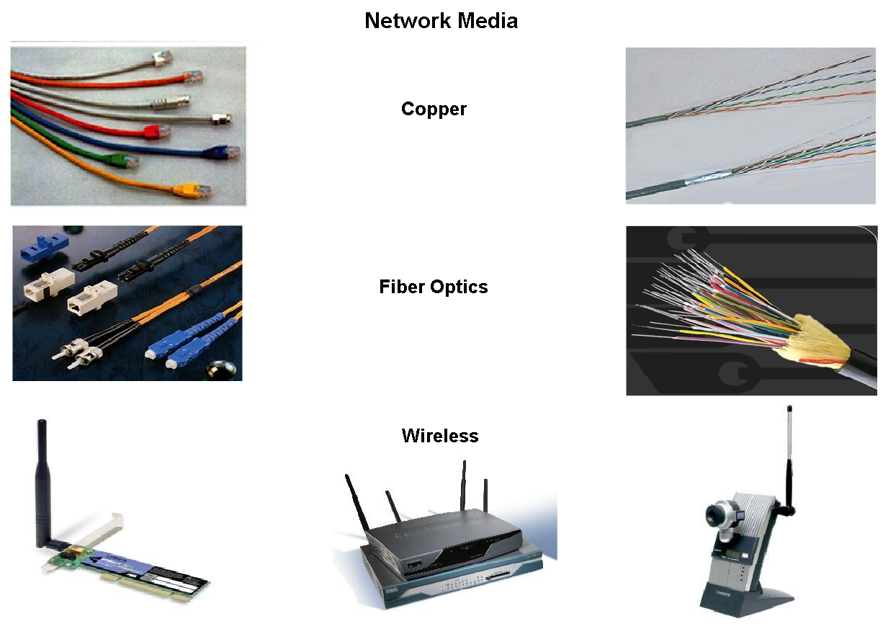
Network Structure
Network media
this is the channel over which a message travels

Slide 9
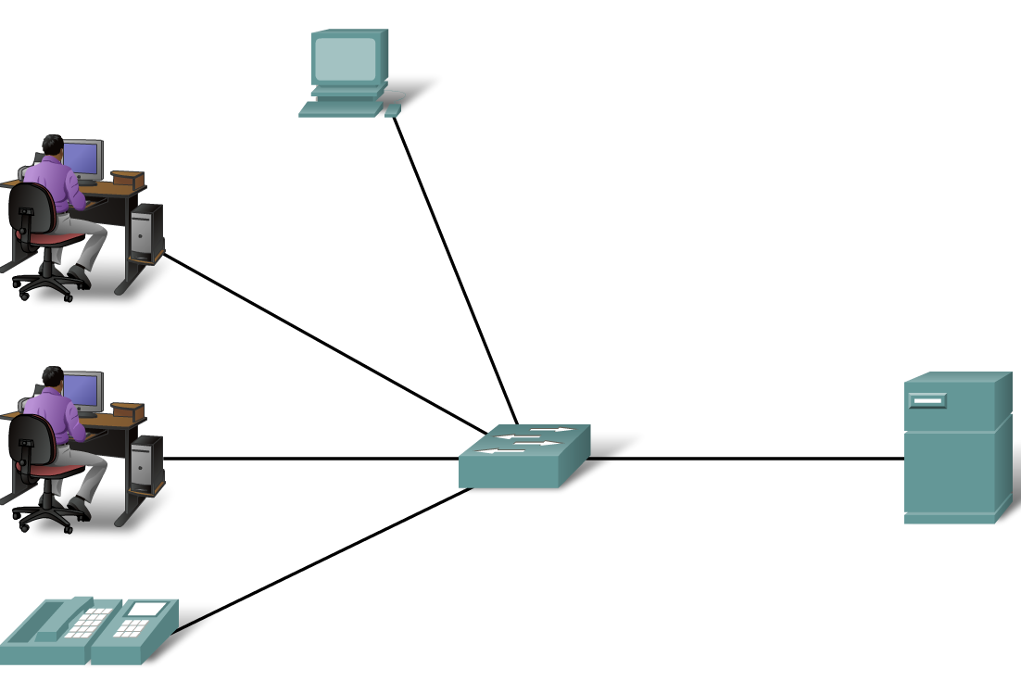
Network Types
Local Area Networks (LANs)
- A network serving a home, building or campus is considered a Local Area Network (LAN)

Slide 10
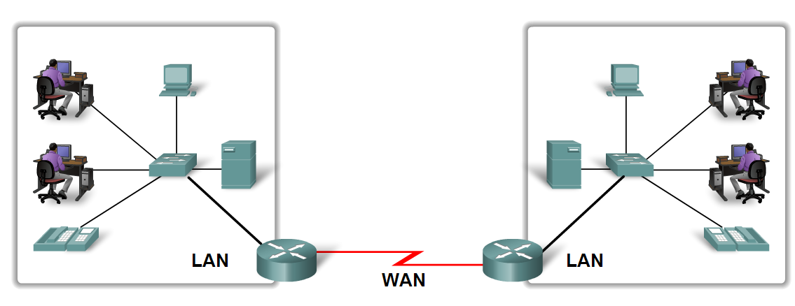
Network Types
Wide Area Networks (WANs)
- LANs separated by geographic distance are connected by a network known as a Wide Area Network (WAN)

Slide 11
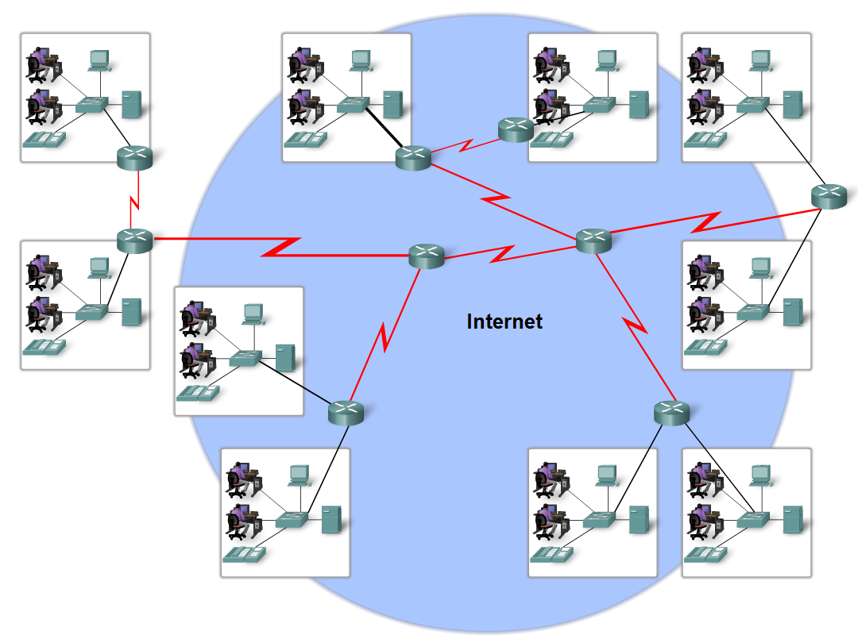
Network Types
Internet
The internet is defined as a
global mesh of interconnected networks

Slide 12
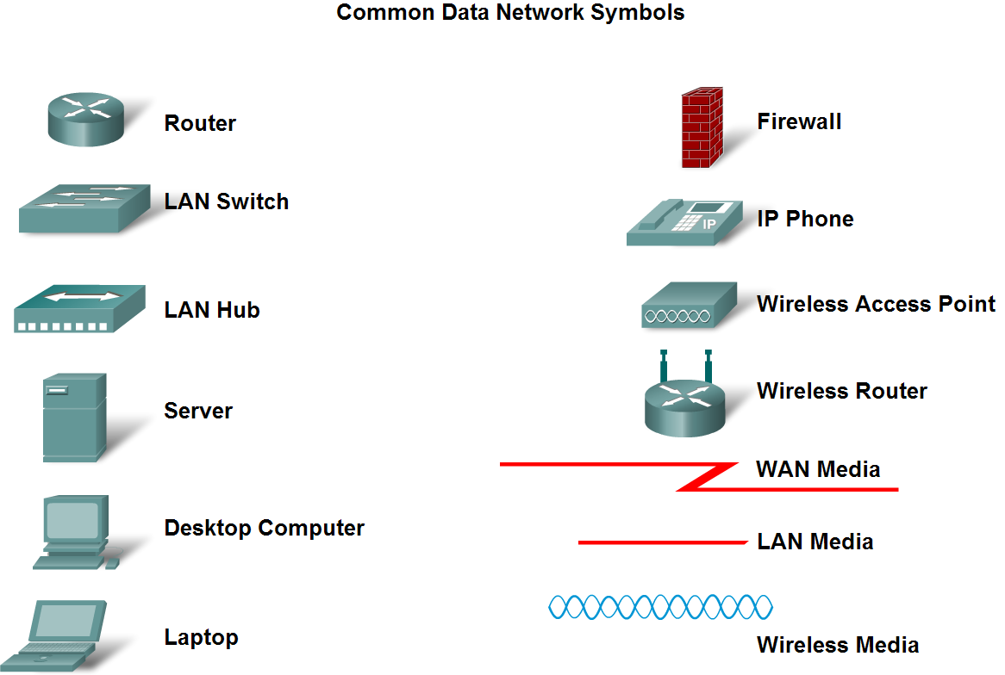
Network Types
Network representations

Slide 13
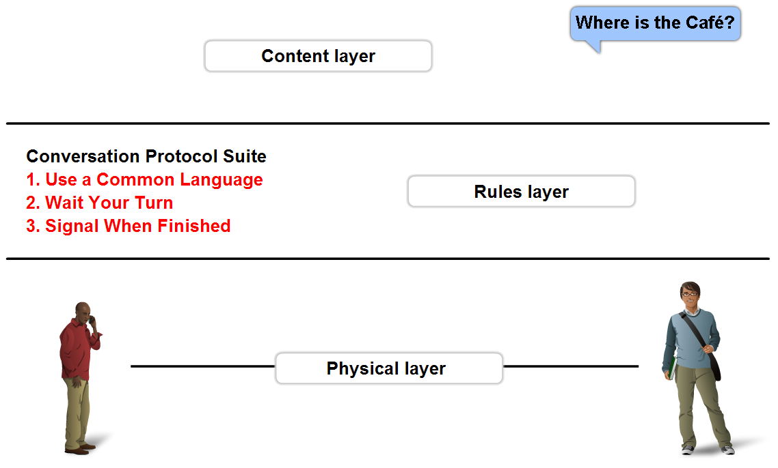
Function of Protocol in Network Communication
A protocol is a set of predetermined rules

Slide 14
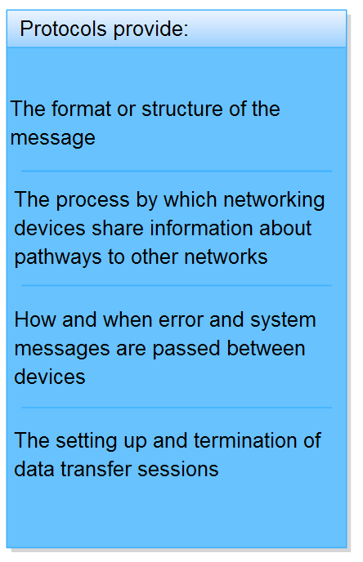
Function of Protocol in Network Communication
Network protocols are used
to allow devices to
communicate
successfully

Slide 15
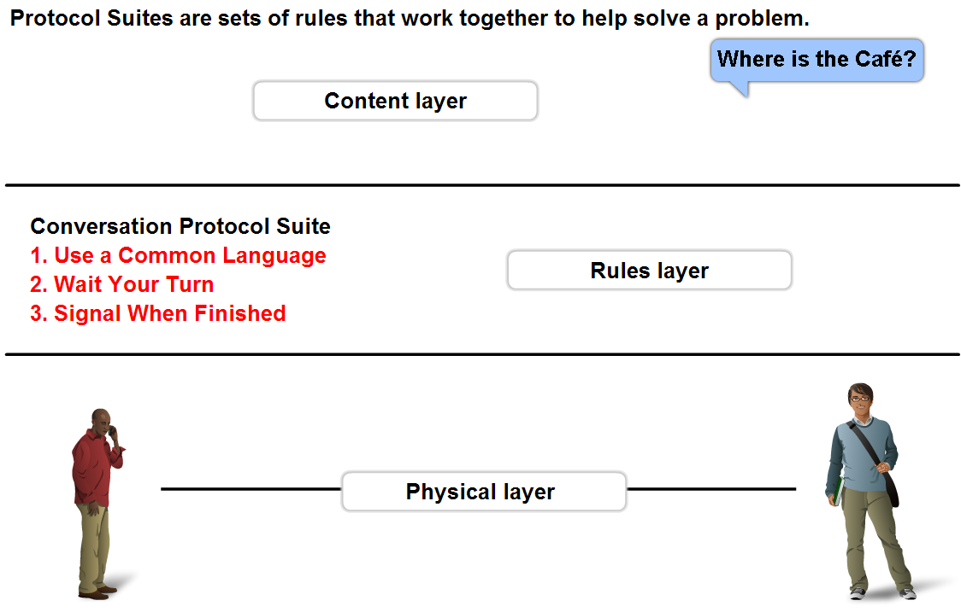
Function of Protocol in Network Communication
Protocol suites and industry standards
A standard is
a process or protocol that has been endorsed by the networking industry and ratified by a standards organization

Slide 16
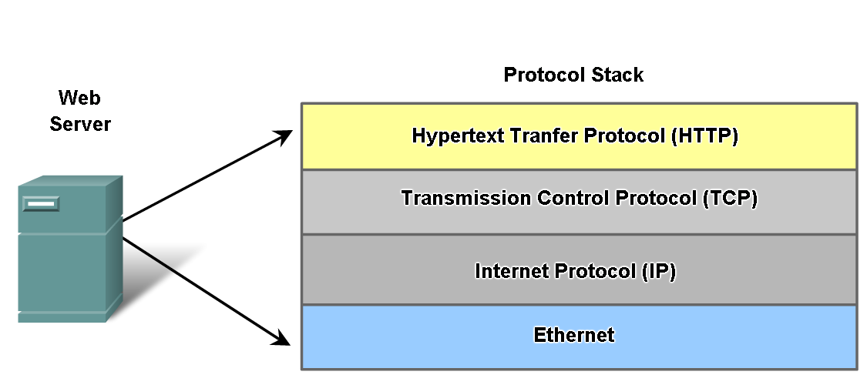
Function of Protocol in Network Communication
Different protocols and how they interact

Slide 17
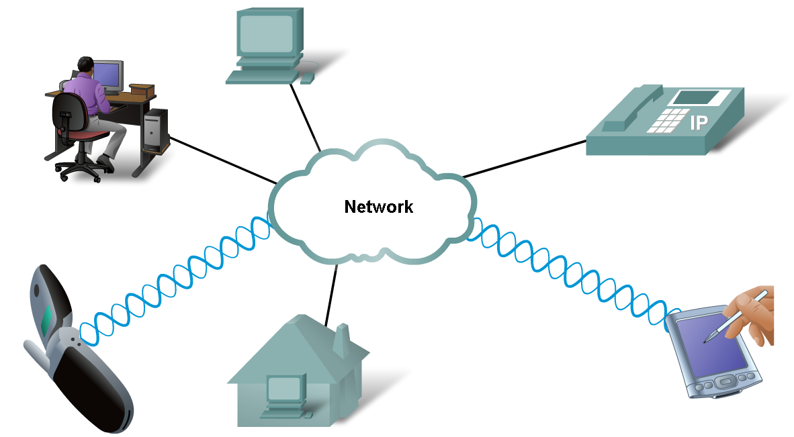
Function of Protocol in Network Communication
Technology independent Protocols
-Many diverse types of devices can communicate using the same sets of protocols. This is because protocols specify network functionality, not the underlying technology to support this functionality.

Slide 18
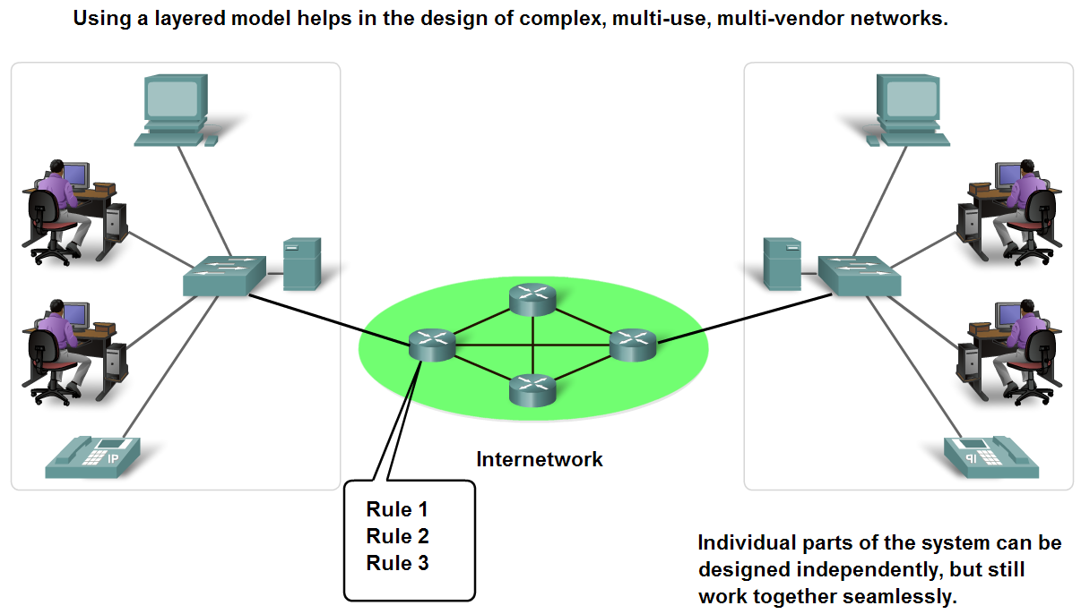
Layers with TCP/IP and OSI Model
Benefits of using a layered model
Benefits include
assists in protocol design
fosters competition
changes in one layer do not affect other layers
provides a common language

Slide 19
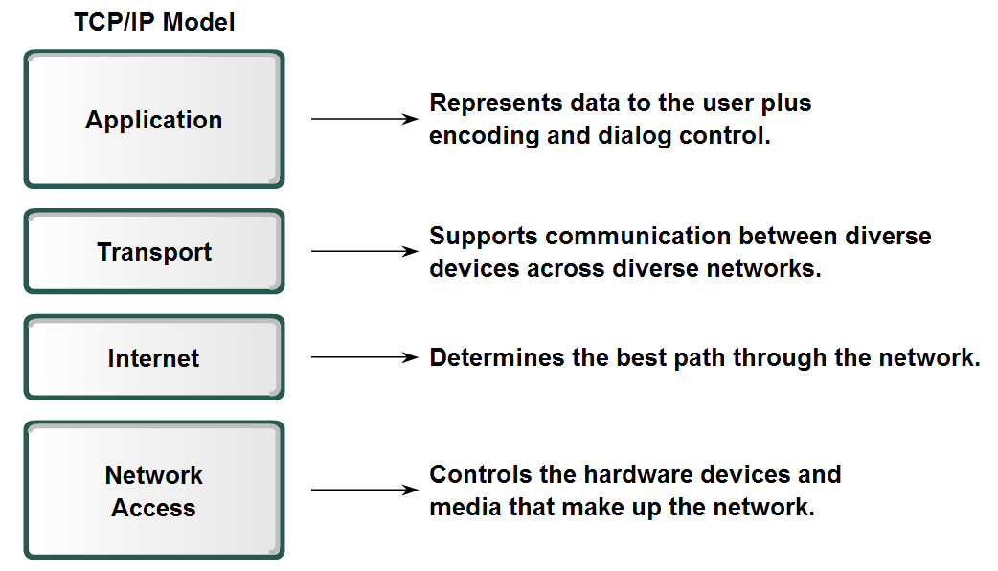
Layers with TCP/IP and OSI Model
TCP/IP Model

Slide 20
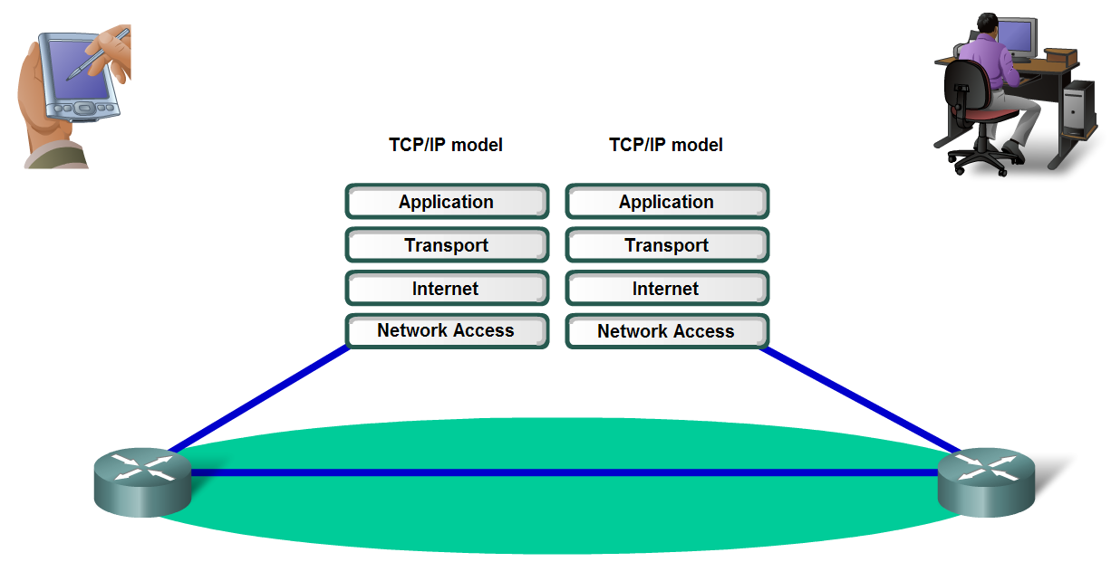
Layers with TCP/IP and OSI Model
The Communication Process

Slide 21
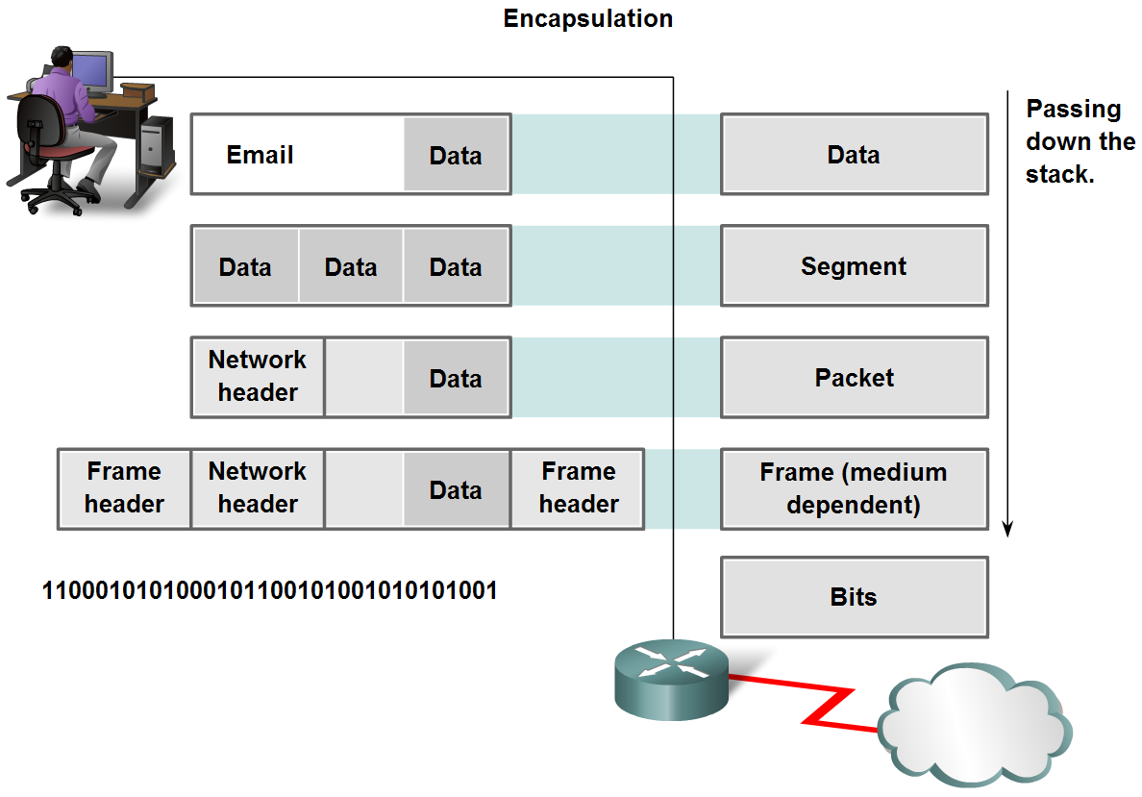
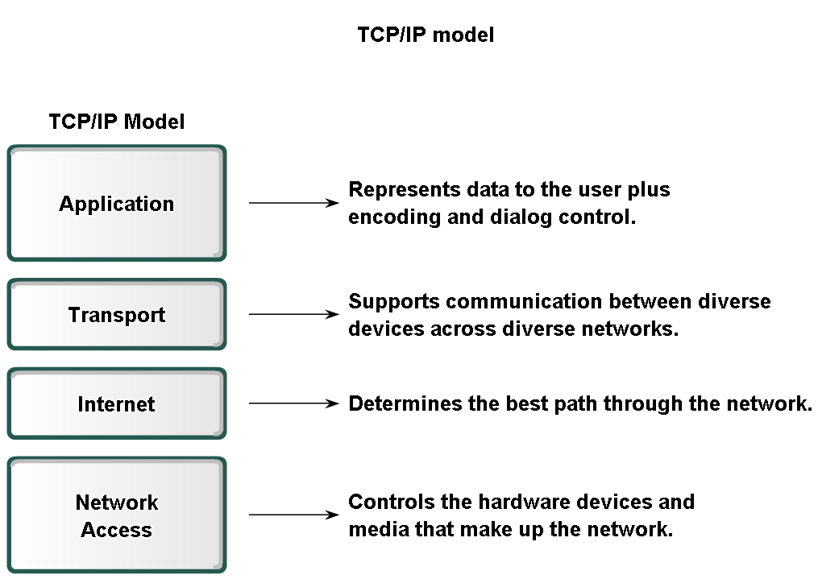
Layers with TCP/IP and OSI Model
Protocol data units (PDU) and encapsulation

Slide 22
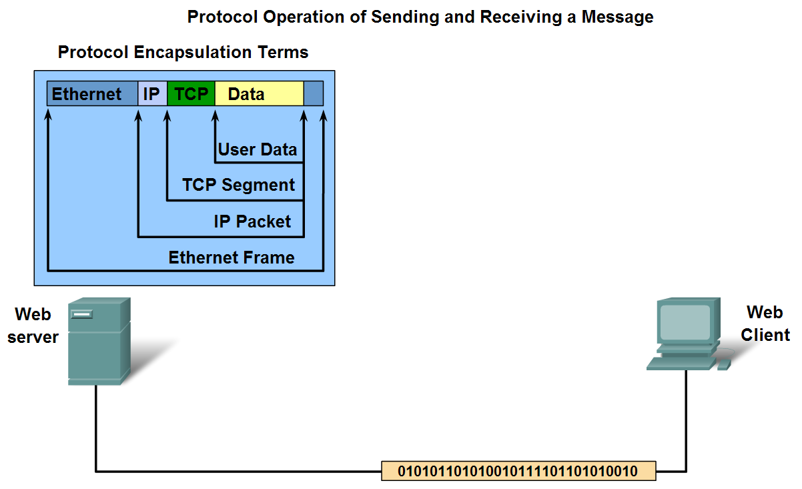
Layers with TCP/IP and OSI Model
The process of sending and receiving messages

Slide 23
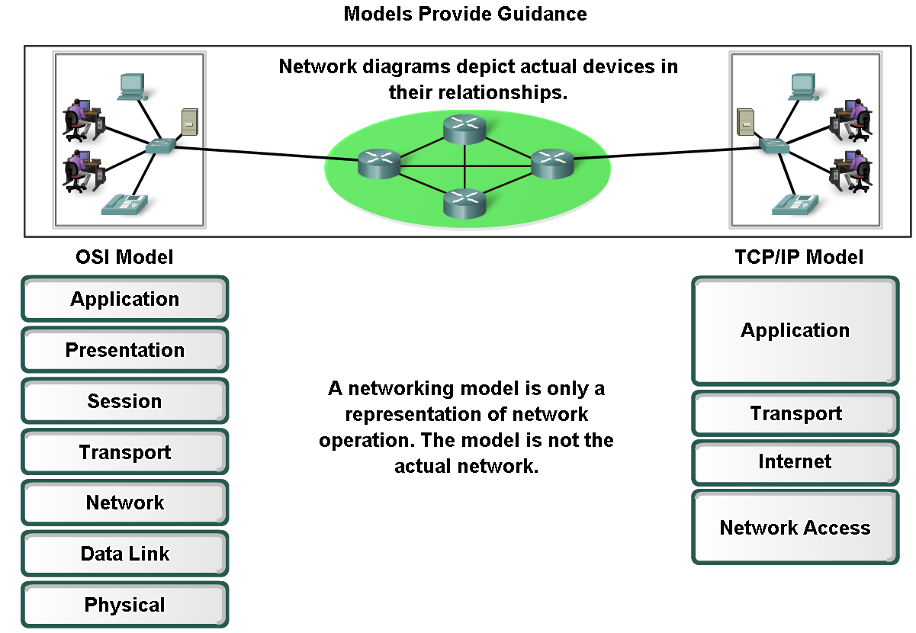
Layers with TCP/IP and OSI Model
Protocol and reference models
A protocol model
provides a model that closely matches the structure of a particular protocol suite.
A reference model
provides a common reference for maintaining consistency within all types of network protocols and services.

Slide 24
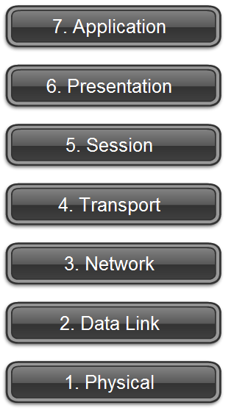
Layers with TCP/IP and OSI Model
OSI Model

Slide 25
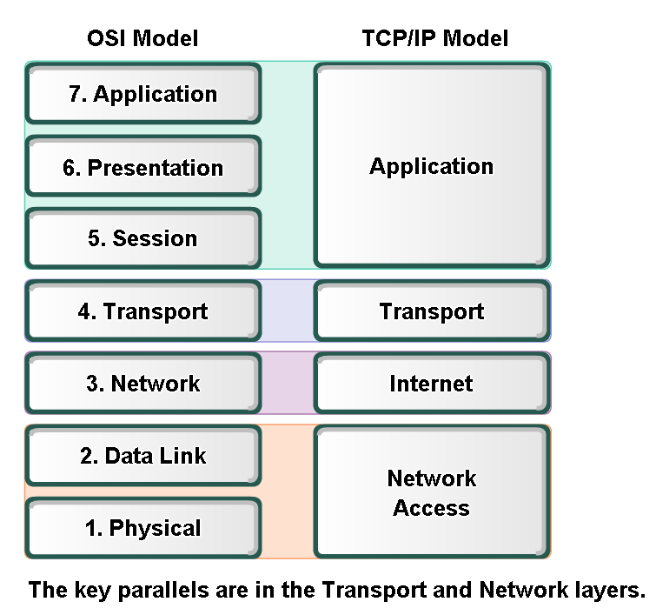
Layers with TCP/IP and OSI Model
Compare OSI and TCP/IP model

Slide 26
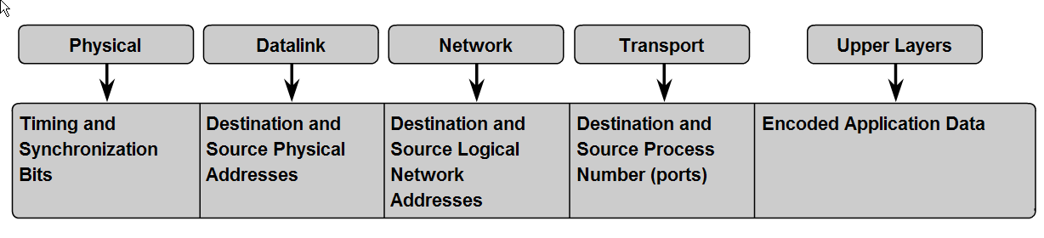
Addressing and Naming Schemes
Labels in encapsulation headers are used to manage communication in data networks

Slide 27
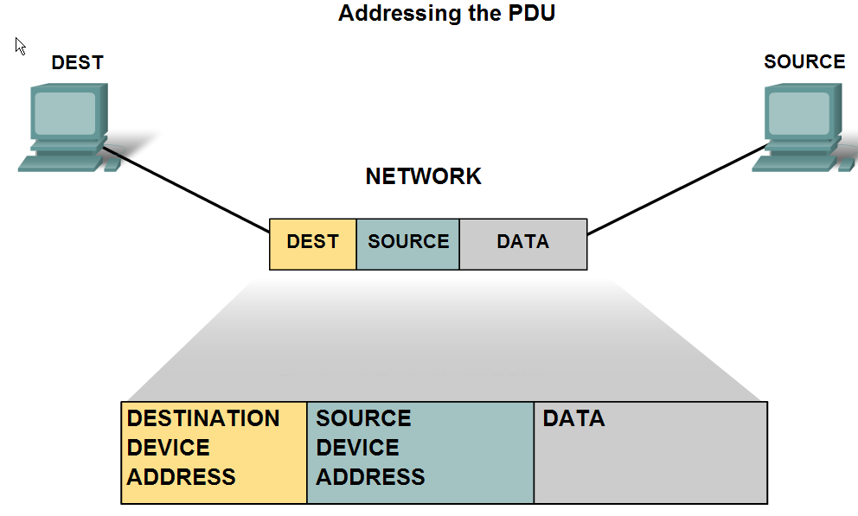
Addressing and Naming Schemes
Examples of Ethernet MAC Addresses, IP Addresses, and TCP/UDP Port numbers

Slide 28
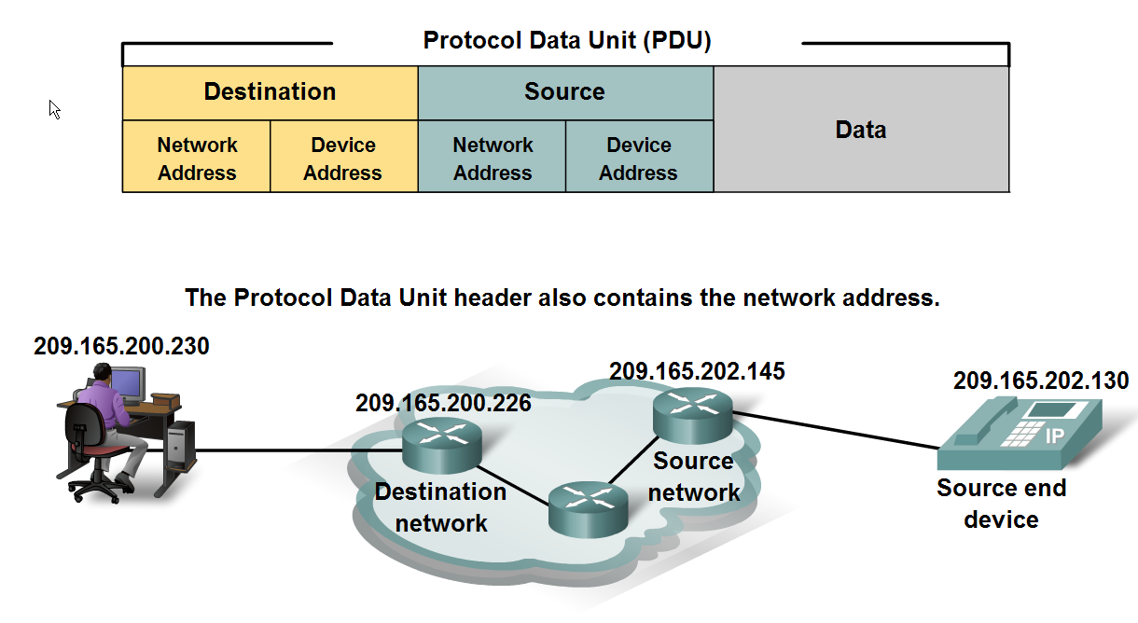
Addressing and Naming Schemes
Labels in encapsulation headers are used to manage communication in data networks

Slide 29
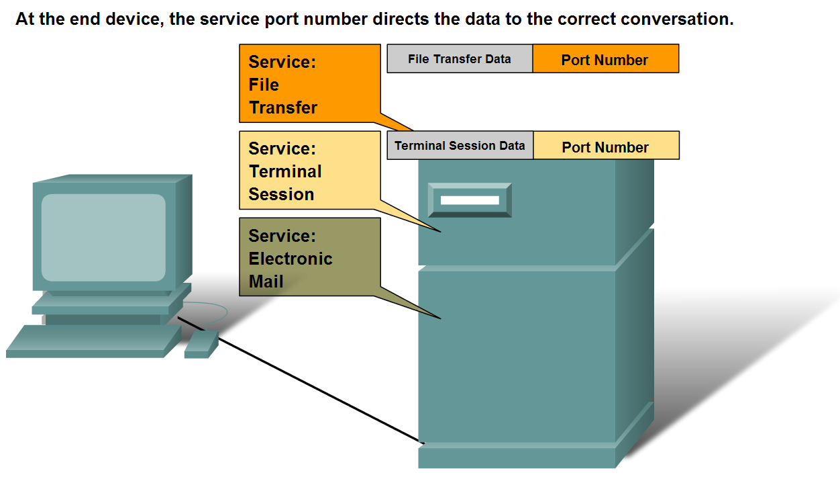
Addressing and Naming Schemes
Information in the encapsulation header is used to identify the source and destination processes for data communication

